Slide 1
Evolving Software Teams: Organizational & Managerial Issues
Damian A. Tamburri, Ph.D.

Slide 2
Different ways to organize people

Slide 3
People management
People have different goals
People and productivity
Group processes
Coordination of work
Importance of informal communication

Slide 4
Mintzberg’s coordination mechanisms
Simple: direct supervision
Machine bureaucracy: standardization of work processes
Divisionalized form: standardization of work products
Professional bureaucracy: standardization of worker skills
Adhocracy: mutual adjustment
Notes:
Simple: few bosses, many workers. The bosses use direct supervision. Often in small organizations.
Machine bureaucracy: work is completely specified. Assembly lines. Little training, much specialization.
Divisionalized form: each division has freedom to reach goals. Control is by regularly measuring the performance of the division.
Professional bureaucracy: skilled professionals are given autonomy, as in hospitals.
Adhocracy: a group of colleagues has to carry out a complex job.
These are obviously extremes.

Slide 5
External and Internal forces
Example context: a complex software development project in a new, not yet explored area, within a government agency
External force: the bureaucratic context is likely to want to push a bureaucratic type of organization, with bosses, and hierarchical decision procedures
Internal force: the project really requires a more democratic, consensus-based type of organization
Notes:
And these forces then easily clash.
See also the London Ambulance Service debacle.

Slide 6
Reddin’s management styles
task directedness
low
high
separation
style
commitment
style
low
relation
directedness
relation
style
integration
style
high
Notes:
Separation style: suited for routine work; efficiency is central theme. Management is bureaucratic. Looks like Mintzberg’s coordination through standardization of work processes style
Relation style: effective where people have to be motivated. Tasks are bound to individuals. Work is innovative. Looks like mutual adjustment scheme
Commitment style: effective when work is done under pressure. Decisions making is not done in meetings; decisions are implied by shared vision of the team. Fits professional bureaucracy.
Integration style: fits when result is uncertain. Work is explorative. Manager has to stimulate and motivate. Looks like mutual adjustment too.

Slide 7
Focus
In both these schemes, we look from the manager to the team.
We may also take the opposite position and consider the relation and task maturity of individual team members.
The manager should align his dealings with team members with their maturity.
Notes:
For example, a fresh graduate may have high task maturity and low relation maturity. His introduction into a skilled team may then warrant some guidance.

Slide 8
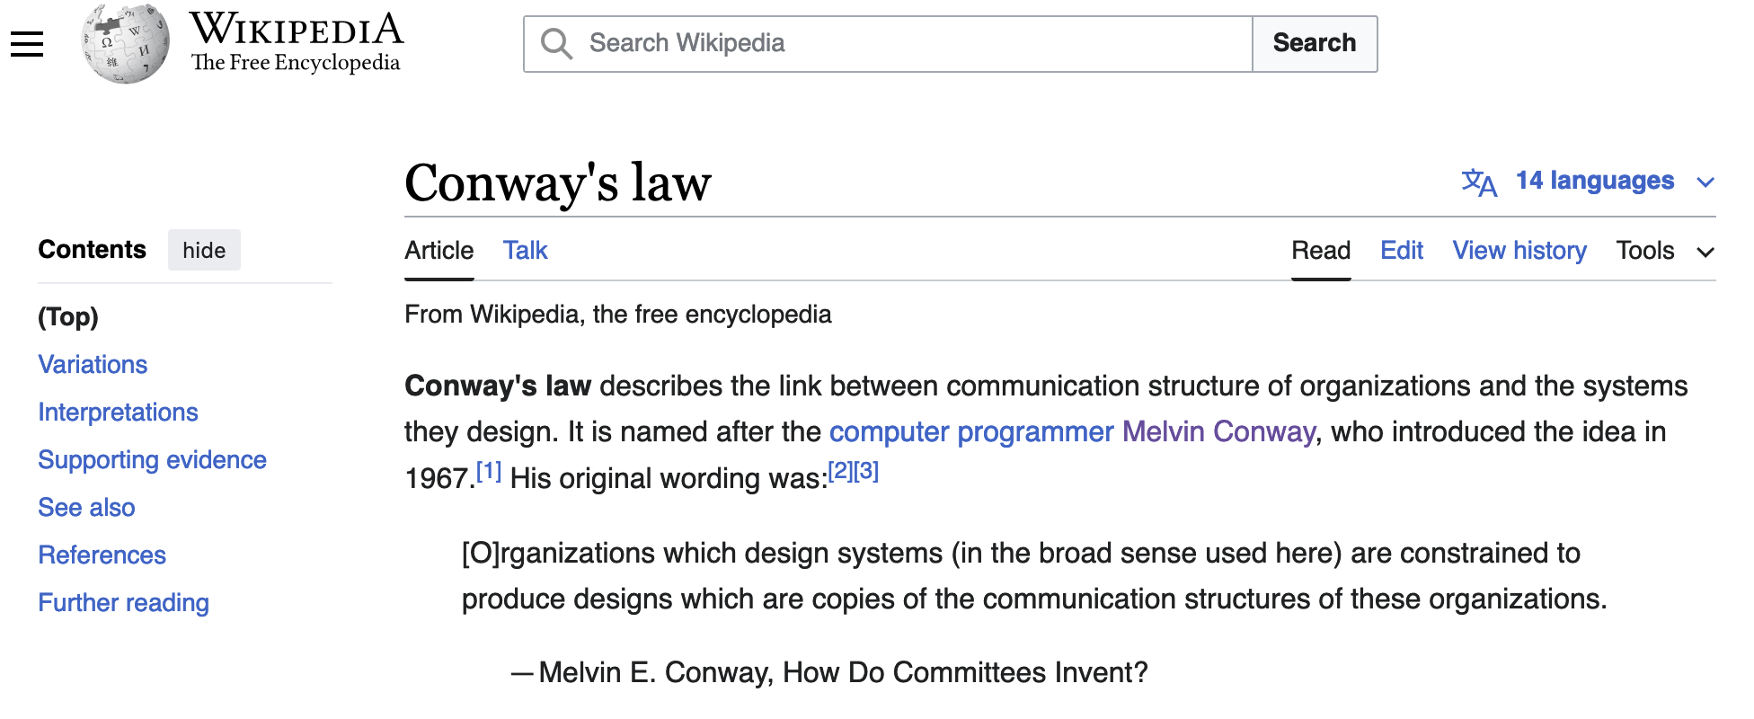
A basic principle… Conway’s law!

Slide 9
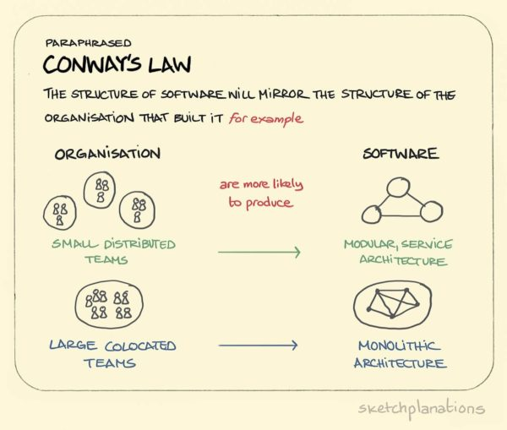
But first… Conway’s law!

Slide 10
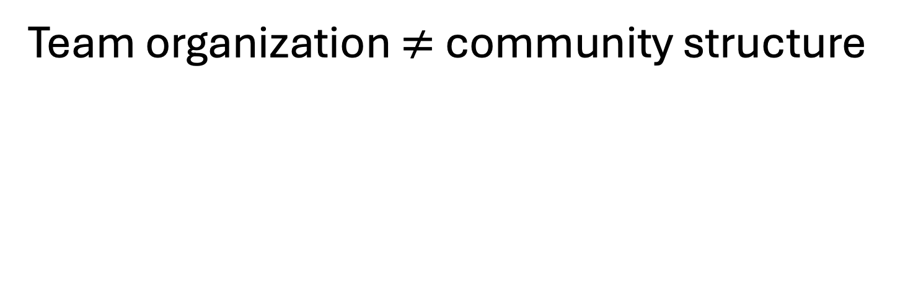
Another basic principle… organizational evolution
Team organization $≠$ community structure

Slide 11
Team Organization vs. Community Structure
Hierarchical organization
Matrix organization
Chief programmer team
SWAT team
Agile team/Extreme Programming (XP)
Open-Source Development
Notes:
The first two (hierarchical and matrix) are traditional team organizations, and not specific to software development.
The latter three are quite specific to s.d.
Chief programmer team was fashionable for a while; originated within IBM. The chief programmer is the first amongst his pals.
SWAT = Skilled Team with Advanced Tools. Goes with RAD -- Rapid Application Development. The team quickly builds a series of prototypes.
Open Structured Team is from Constantine. Looks like chief programmer team, with a few more rules.
XP: Extreme Programming, the latest fad.

Slide 12
Hierarchical team

Slide 13

For example…

Slide 14
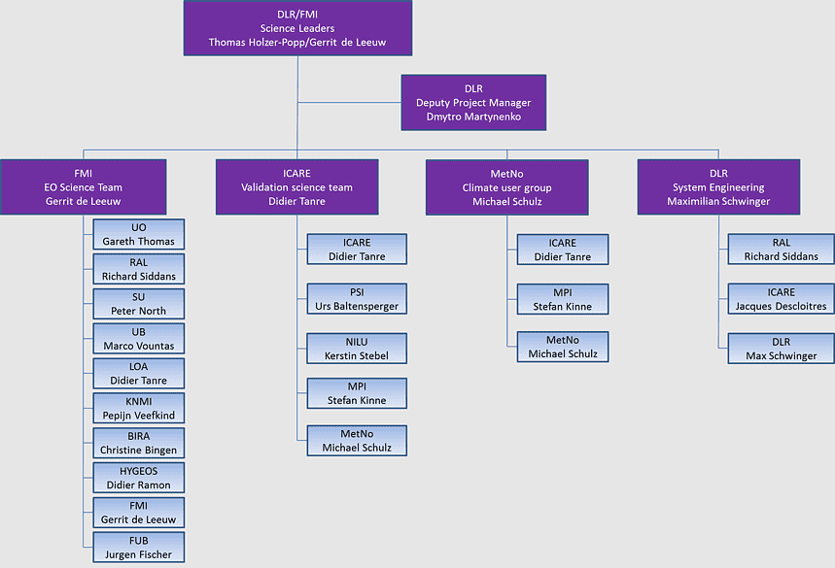

Slide 15
Matrix organization

Slide 16
For example… All EU project-oriented org’s and ISVs
FTE1 | FTE2 | FTE3 | …
0.1 | 0.5 | … | … | … | … | … | …
0.1 | 0.2 | … | … | … | … | … | …
0 | … | … | … | … | … | … | …
… | … | … | … | … | … | … | …
 |  | … | … | … | … | … | …
… | … | … | … | … | … | … | …
WP. 1
WP. 2
WP. x

Slide 17
Chief programmer team

Slide 18
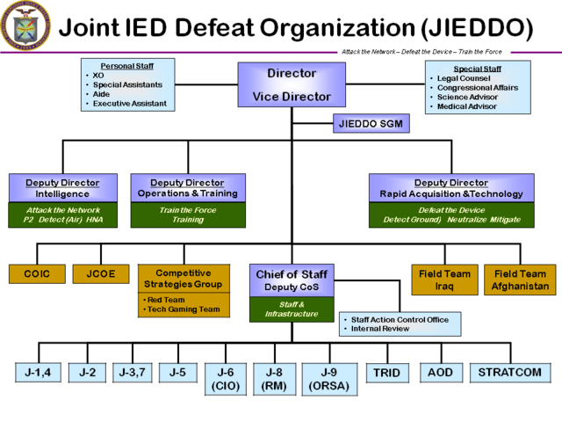
For example… military-grade software organizations

Slide 19
For example… military-grade software organizations

Slide 20
Skilled worker with advanced tools (SWAT)

Slide 21
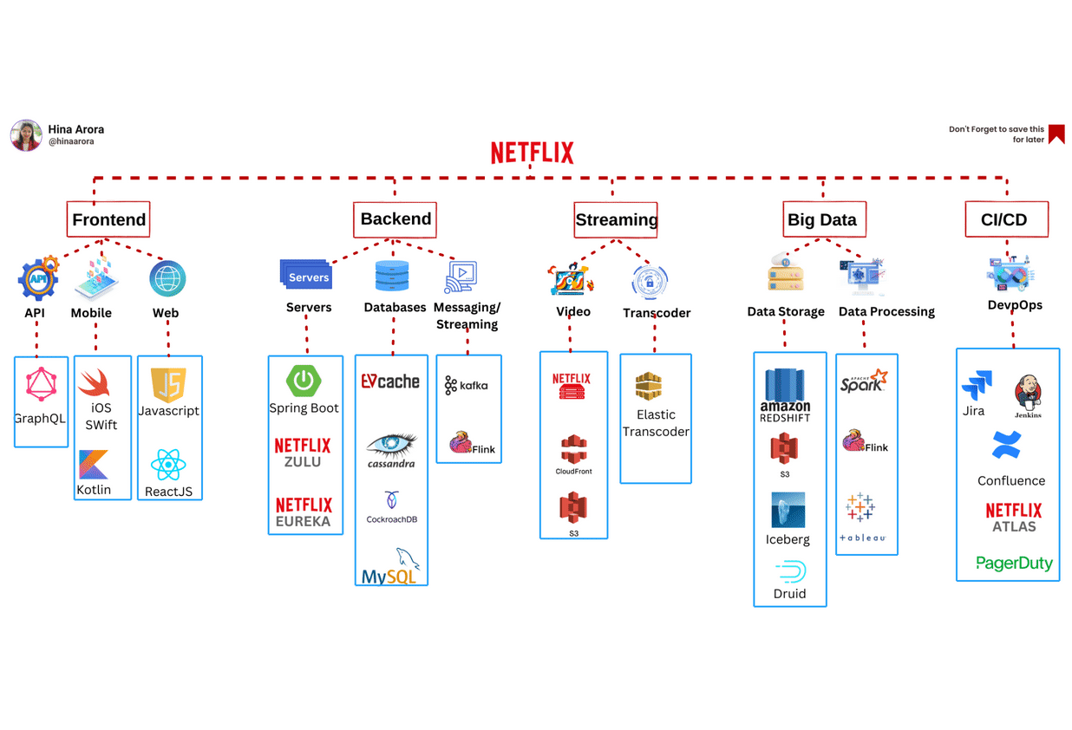

Slide 22
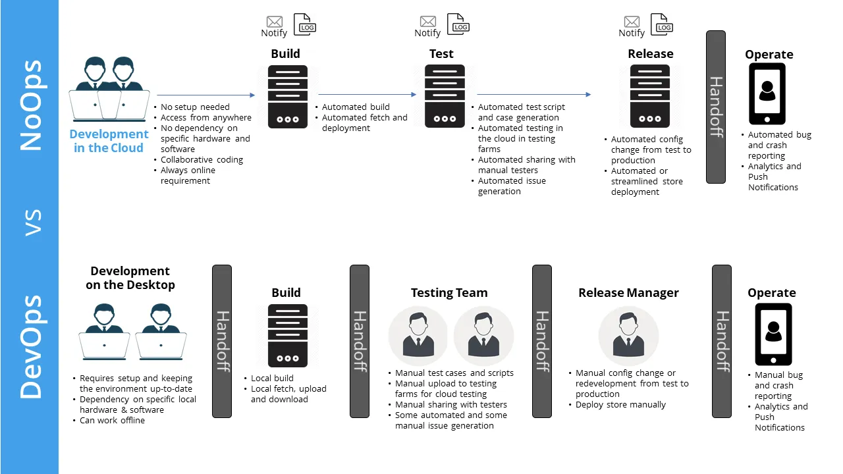

Slide 23
Agile team

Slide 24
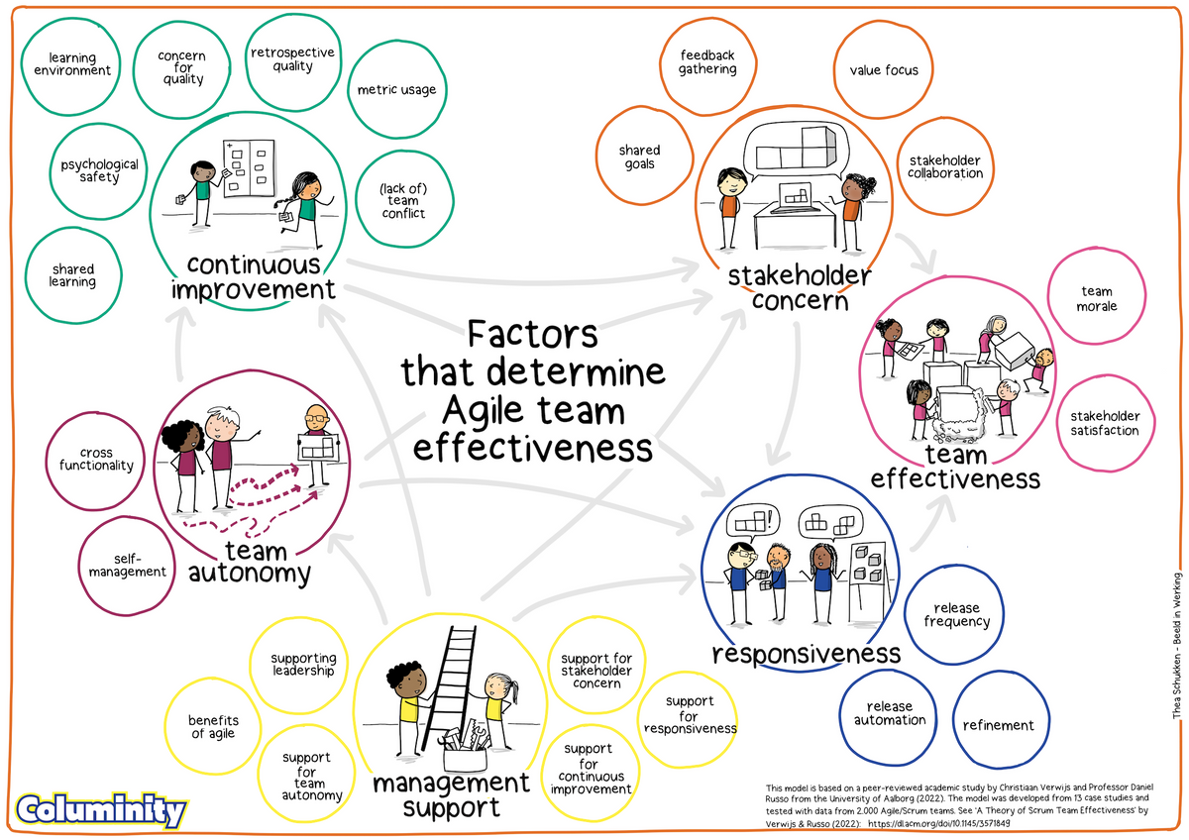

Slide 25
Open-Source Software Development
core team
active users
passive users
co-developers

Slide 26
Technical debt may not be all of it...
Once we understood and started paying attention to technical debt, we figured out that:
Not all technical debt was bad
It could be measured, avoided or turned into acceptable loss
It is just one face of a coin we called Conway’s law:
“software design mirrors the [organizational and social] structure of the organization that builds it”
???
Technical Debt

Slide 27
What is social debt?
By analogy with technical debt, Social Debt is:
“Unforeseen project cost connected to a sub-optimal organizational-social structures”
To make an even deeper analogy: “ - not quite right a development community - which we postpone, refuse or refrain from making it right”
[Ward Cunningham - 1992, revisited]

Slide 28
What is social debt?
By analogy with technical debt, Social Debt is:
“Unforeseen project cost connected to a sub-optimal organizational-social structures”
Community
Feature
POSITIVE
EFFECT
Community
Architecture
Community
Defect
NEGATIVE
EFFECT
Social Debt

Slide 29
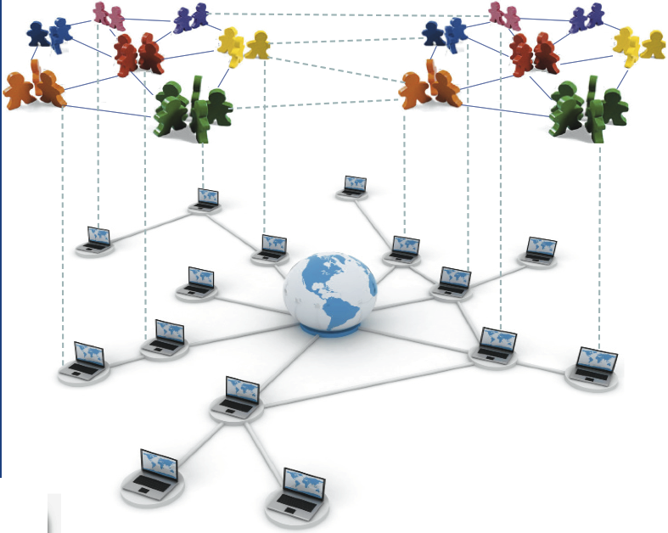
Playground for Social Debt: social and organizational structures for Sw. Eng.
“the graph of interactions, patterned relations and arrangements emerging between individuals in the same endeavor”...
Some intrinsic complexities on such a graph:
13 Organizational types (types of graphs sub-graphs)
(at least) 81 properties observed so far that define types
...

Slide 30
Playground for Social Debt: social and organizational structures for Sw. Eng.
Dev. Interactions
Dev. 2
Dev. 3
Dev. 1
…
Dev. N-1
Dev. 4
Dev. N
Social Relations (Between People) in the Structure Yield Properties of the Structure:
Average Cognitive Distance
Strength of ties
Negative ties
Reciprocity
….
Which equation of these properties is responsible for social debt?

Slide 31
Playground for Social Debt: social and organizational structures for Sw. Eng.
Art. 1
Art. 3
Art. 2
Task Allocations
Art. N
Dev. 2
Dev. 3
Dev. 1
…
Dev. N-1
Art. 4
Dev. 4
Dev. N
Organizational and Technical Relations (between Artifacts and People) in the Structure Yield Properties of the Structure:
Health
Type
Access Privilege
Reputation
Work Frequency
Org. Problems
….
Which equation of these properties is responsible for social debt?

Slide 32
Playground for Social Debt: social and organizational structures, 13 types

Slide 33
Playground for Social Debt: social networks and their analysis, i.e., SNA!
Social-Networks Analysis (SNA): “Visualize and analyze patterns of inter-actor contact as these can have effects on the spread of “goods”, power or community dynamics that cannot be seen focusing only on individual behavior.”
SNA in Sw. Eng. ➔ “Study socio-technical emergent behavior across development networks”
Art. 1
Art. 3
Art. 2
Art. N
Dev. 2
Dev. 3
Dev. 1
…
Dev. N-1
Art. 4
Dev. 4
Dev. N

Slide 34
Playground for Social Debt: social and organizational structures?? Where are they??
Mine data from task databases (JIRA, BugZilla, etc.)
Build a social network

Slide 35
Playground for Social Debt: social and organizational structures?? Where are they??
Mine data from task databases (JIRA, BugZilla, etc.)
Build a social network
For Example... Eclipse MyLyn

Slide 36
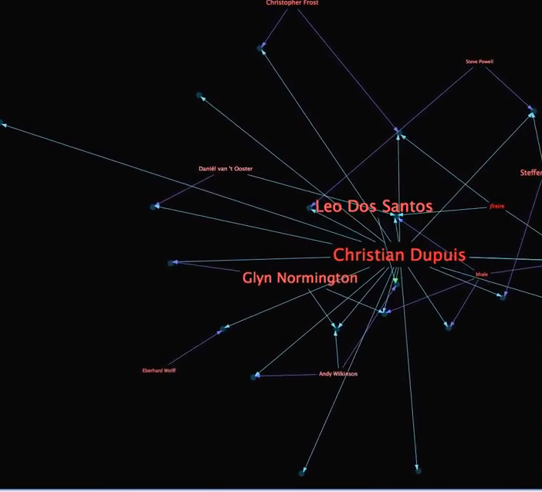
Playground for Social Debt: social and organizational structures?? Where are they??
Mine data from task databases
Build a social network
Mine data from task databases (JIRA, BugZilla, etc.)
Build a social network
For Example... Eclipse MyLyn
Spring Task DB

Slide 37
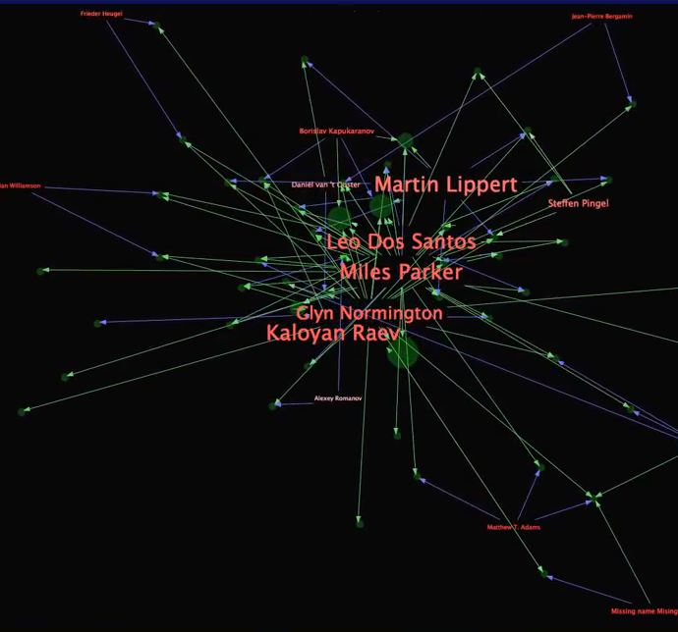
Playground for Social Debt: social and organizational structures?? Where are they??
Mine data from task databases
Build a social network
Mine data from task databases (JIRA, BugZilla, etc.)
Build a social network
For Example... Eclipse MyLyn
Spring Task DB
SpringSource Task DB

Slide 38
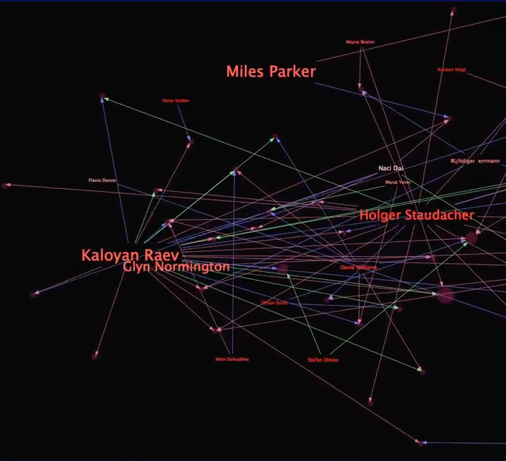
Playground for Social Debt: social and organizational structures?? Where are they??
Mine data from task databases
Build a social network
Mine data from task databases (JIRA, BugZilla, etc.)
Build a social network
For Example... Eclipse MyLyn
Spring Task DB
SpringSource Task DB
Eclipse Bugzilla
...

Slide 39
You add some SNA and you get something like this...

Slide 40
You add some SNA and you get something and this...

Slide 41
You add some SNA and you get something and this...

Slide 42
You add some SNA and you get something and this...

Slide 43
You add some SNA and you get something and this!!!
Org. 3
Org. 2
Org. 1

Slide 44
For Example…
SCENARIO: a collaboration between Org. 1 and rest of open-source community changes interaction protocols.
DECISION: Org 1 deploys “Intellectual propriety” barriers to protect industrial secrets.
This can produce two types of (negative?) effects:
Organizational/Social: e.g. collaboration becomes too formal ➔ fear
Technical: e.g. tasks and artifacts cannot be shared as freely ➔ slower lifecycle
Org. 1
Open-Source Community
Intellectual propriety

Slide 45
Use SNA to evaluate interaction patterns between sub-organizations
Org. 3
Org. 1

Slide 46
For Example… cont’d
The effects of the socio-technical decision can lead to a less-than-ideal social community…
… this consequence leads to some sort of “social debt”, i.e. invisible project cost due to a sub-optimal community
Social Debt
Social Community ⁰
Socio-tech dec.
Social Community ¹
“optimal” Social Community
…
Notes:
What is social debt? The extra, unforeseen project cost connected to a sub-optimal community layout, caused by sub-optimal socio-technical decisions.

Slide 47
Social Debt, Insights from Industry: Explorative Empirical Research in a Large GSD Project
RQ: What are the causes and effects of social debt in industry?
22 people
managers, arch., developers, and operators, all directly/indirectly involved in the study
5 Researchers
3 senior
2 junior
Complex architecture
4-tier
mission-critical with high-dependability
15-30 distributed components
Complex Org. Structure
22 people divided in three global sites
Complex interaction protocols across (e.g., protect industrial secrets)
...
Notes:
Code churn is defined as lines added, modified or deleted to a file from one version to another.

Slide 48
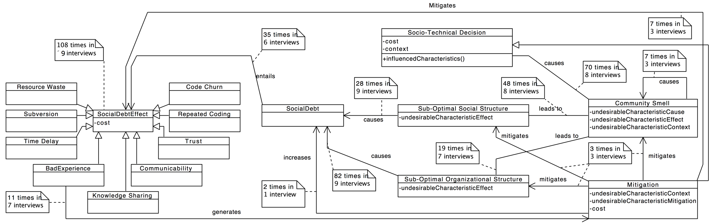
Social Debt, Insights from Industry (1): Social Debt Interpretative Framework
Notes:
Code churn is defined as lines added, modified or deleted to a file from one version to another.

Slide 49
Social Debt, Insights from Industry (1): Social Debt Interpretative Framework
Empirical Software Engineering –
RQ: What are the causes and effects of social debt in industry?
Socio.-Tech. Decisions
Debt
Effects
Social
Debt
Org. - Soc. Structure
Community “Smells”
Notes:
Code churn is defined as lines added, modified or deleted to a file from one version to another.

Slide 50
Social Debt, Insights from Industry (1): Social Debt Interpretative Framework
Socio.-Tech. Decisions
Debt
Effects
Social
Debt
Org. - Soc. Structure
Community “Smells”
Notes:
Code churn is defined as lines added, modified or deleted to a file from one version to another.

Slide 51
Social Debt, Insights from Industry (2): Community Smells
8 distinct patterns, for example:
- “black-cloud effect”

Slide 52
Use SNA to measure “boundary spanning” across development sub-communities
Org. 3
Org. 1
Notes:
Less than half of the people in either org., then you’re asking for trouble

Slide 53
Social Debt, Insights from Industry: Explorative Empirical Research in a Large GSD Project
RQ: What are the causes and effects of social debt in industry?
Socio-Technical decisions cause social debt
Community Smells cause social debt
Some smells can be somehow mitigated
Smells can be predicted through data-mining and SNA
Social Debt Costs amounted to 23% overhead (i.e. 3 ManMonths for 100K € per MM)
Notes:
Code churn is defined as lines added, modified or deleted to a file from one version to another.

Slide 54
From Technical to Social debt: code Vs. community smells
Technical Debt, Code Smells
Social Debt, Community Smells
Data-mining of software code
Look for recurrent patterns bearing negative and invisible value in the long run
Evaluate resulting cost
Devise coding or architecture decision practices
Data-mining of software code and people matching it
Use SNA to evaluate social and organizational structure
Use community smells looking for debt
Devise organizational or social adaptation dynamics

Slide 55
From Technical to Social debt: code Vs. community smells
Technical Debt, Code Smells
Social Debt, Community Smells
Data-mining of software code
Look for recurrent patterns bearing negative and invisible value in the long run
Evaluate resulting cost
Devise coding or architecture decision practices
Data-mining of software code and people matching it
Use SNA to evaluate social and organizational structure
Use community smells looking for debt
Devise organizational or social adaptation dynamics
Both at the same time!!!

Slide 56
From Technical to Social debt: socio-technical code analysis
Repo. 1 (Comp. 1,2,3)
Org. 3
Repo. 2 (Comp. 5,7)
Repo. 3 (Comp. 9-11)
Org. 1
Notes:
Less than half of the people in either org., then you’re asking for trouble

Slide 57
From Technical to Social debt: social-code graphs (SCGs)
SCGs “A formalism to support socio-technical code analysis”:
Developers get bigger as they contribute;
Artifacts get bigger as they are contributed to;
Interactions change shape as interactions define;
...

Slide 58
Next up…
Software Community Structures, types and inefficiencies
Software Community Smells!

Slide 59
Summary
Software is written by humans
Coordination issues/management styles
Common team organizations in software development:
Hierarchical team
Matrix organization
Agile team
Open-source development

Slide 60
Wrap-up for today: general rules for team org.
Use fewer, and better, people
Fit tasks to people
Help people to get the most out of themselves
Strive for a well-balanced team
If someone doesn’t fit the team: influence a change the team!
Notes:
- the best people are a bargain
- fit tasks to people: in particular, make sure that technical people have career paths as well
- help people: avoid the reverse Peter Principle: people rise within an organization until they become indispensible, e.g. a programmer who is the only one who knows everything about a particular system. And the Paul Principle: people rise to a level at which their expertise becomes obsolete.

